Slide 1

Short (but sweet) R workshop
Lana Bojanić

Slide 2
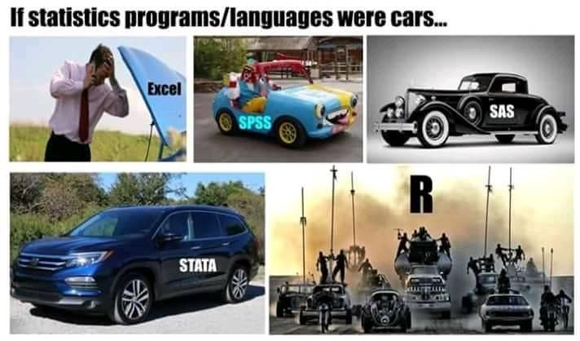
Why bother?
FREE!
Versatile
Huge community

Slide 3
#Let's get started!

Slide 4
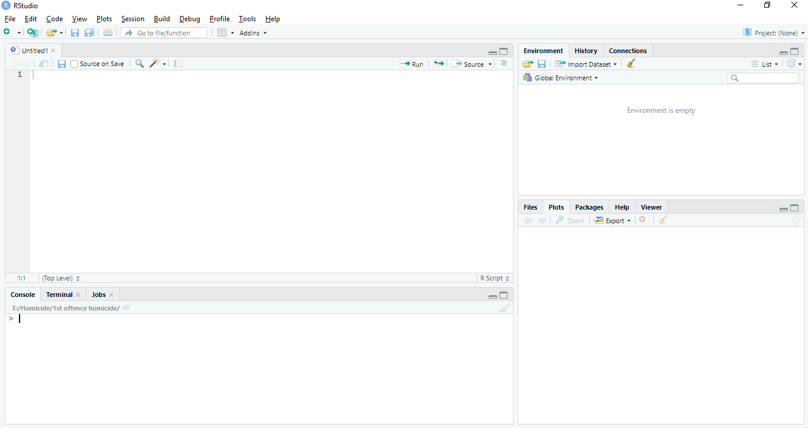
Let’s start

Slide 5
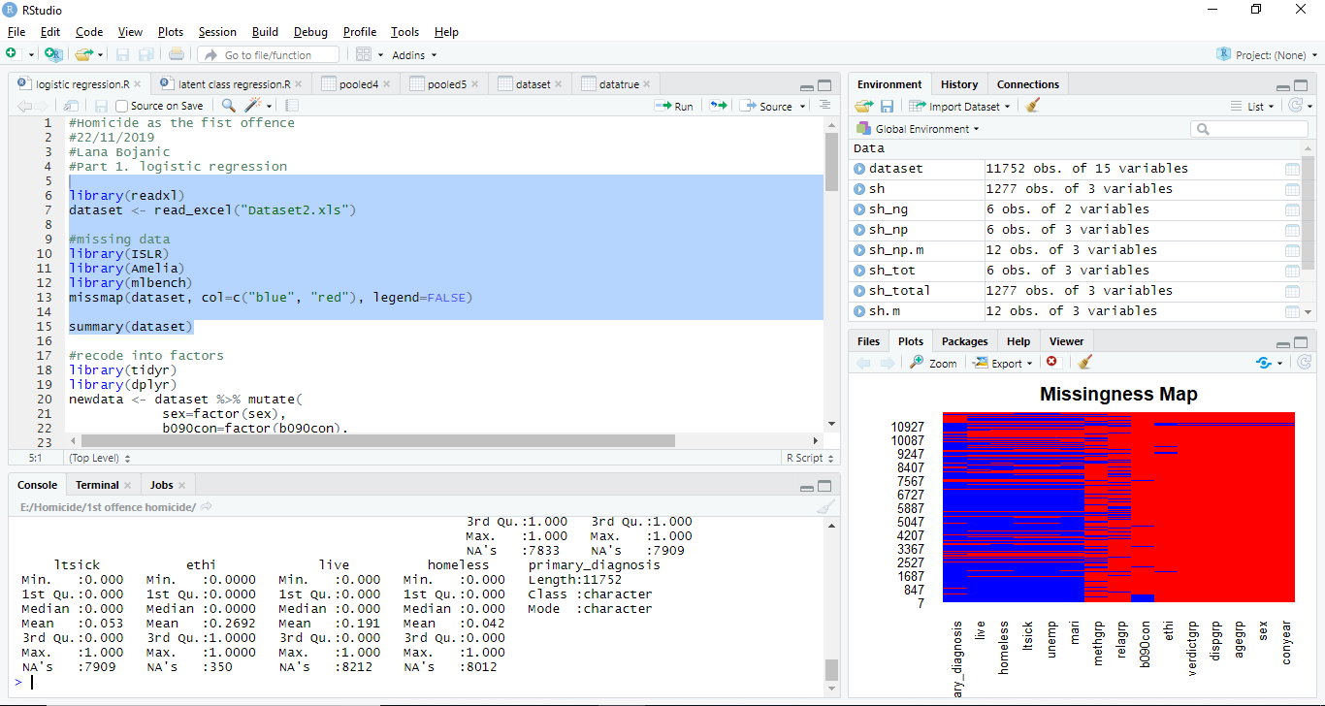
Notes:
To execute code: select, then ctrl+Enter

Slide 6
1. Read data
Setting up working directory
See where you are- getwd()
See where your data are
Set a directory- setwd("E:/Documents/WhereMyDataAre")
Read data
data <- read.csv(file= “countries.csv”, header = TRUE)
View(data)
class(data)
R comes with built-in datasets for practice!
Notes:
R can read almost all data formats
Package here

Slide 7
2. Explore data
summary(data)
Gives mean, median, min and max
We want variance and standard deviation too
install.packages("pastecs")
library(pastecs)
res <- stat.desc(data[,-1])
round(res,2)
Notes:
#stat.desc cannot handle catergorical data, we removed var Country (first column)
#rounded output to two decimals

Slide 8
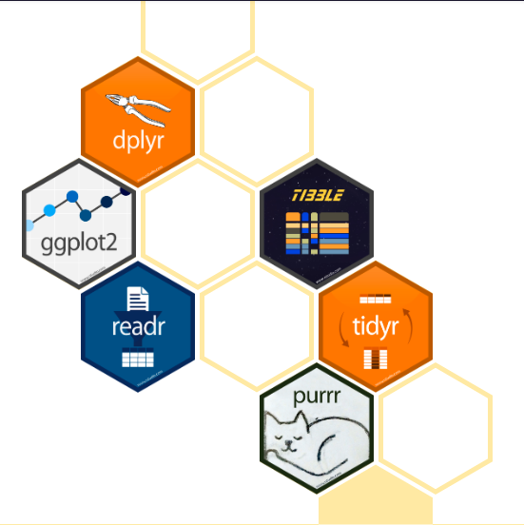
2. Explore data
Interesting, but we want to know more…
Time for tidyverse!
install.packages(“tidyverse”)
library(tidyverse)
Notes:
So far we have used built in packages such as {base}, {utils}, {stats}
Install once, call every time
Tidyverse is a collection of packages

Slide 9
2. Explore data- tidyverse
Cases per year
data %>% count(Year, wt=Deaths)
Rates
data %>% mutate(Rate= Deaths/Population * 10000)
TIP: what does it do? ?mutate
Save results
data <- data %>% mutate(Rate= Deaths/Population * 10000)
Notes:
Wt weight by
R enables you to take the output from one function and pass in on to another.

Slide 10
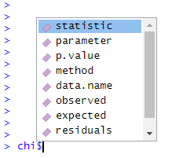
2. Explore data
χ² test
Subset dataframe
data_ab <- data[which(data$Country=='A' | data$Country=='B'),]
chi <- chisq.test(data_ab$Deaths)
Explore your analysis!
Notes:
data[row,column]

Slide 11
4. Common analyses
} built in stats package
Regression glm()
T-test t.test()
Factor analysis factanal()
… and many more!

Slide 12
3. Visualize data
Visualise changes in rates over time
library(ggplot2)
ggplot(data, aes(Year, Rate)) +
geom_line(aes(group = Country), colour = "grey50") + geom_point(aes(colour = Country))

Slide 13
3. Visualize data
ggplot(data, aes(Year, Rate)) +
geom_line(aes(group = Country), colour = "grey50") +
geom_point(aes(colour = Country)) +
scale_x_continuous(breaks = c(2010, 2011, 2012, 2013, 2014,
2015, 2016, 2017, 2018)) +
theme(panel.grid.major = element_blank(),
panel.grid.minor = element_blank(),
panel.background = element_blank(),
axis.line.x = element_line(color = "black"),
axis.line.y = element_line(color = "black"),
axis.title.x = element_text(size = 10),
axis.title.y = element_text(size = 10))

Slide 14
3. Visualize data-export
Save the result!
pl <- ggplot(data, aes(Year, Rate)) +
. . .
Export in tiff
tiff("pl.tiff", units="in", width=7, height=5, res=400)
plot(pl)
dev.off()

Slide 15
3. Visualize data-export

Slide 16
3. Visualise data- Animation
Install and call gganimate and gifski
Add the animation
pl2 <- pl + transition_reveal(Year)
pl2 <- animate(pl2, duration = 5, fps = 20, width = 700, height = 500, renderer = gifski_renderer())
Export animation
anim_save("output.gif", animation = pl2)

Slide 17
3. Visualise data- Animation

Slide 18
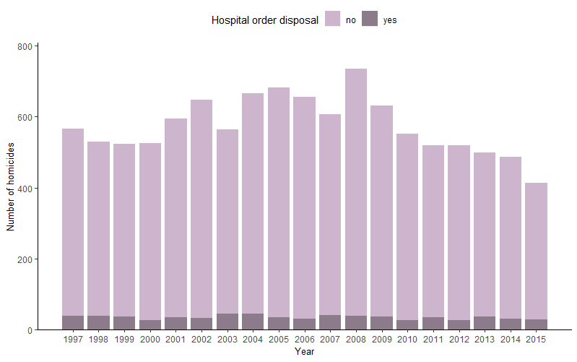
3. Visualize data- other

Slide 19
3. Visualize data- other

Slide 20
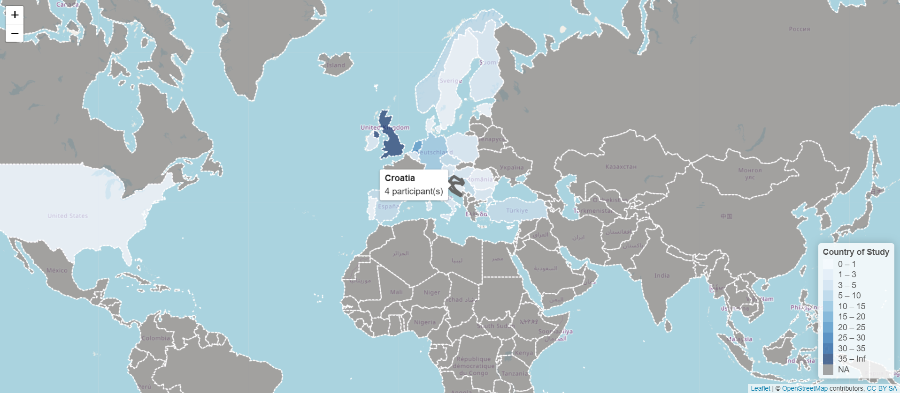
3. Visualize data- other

Slide 21
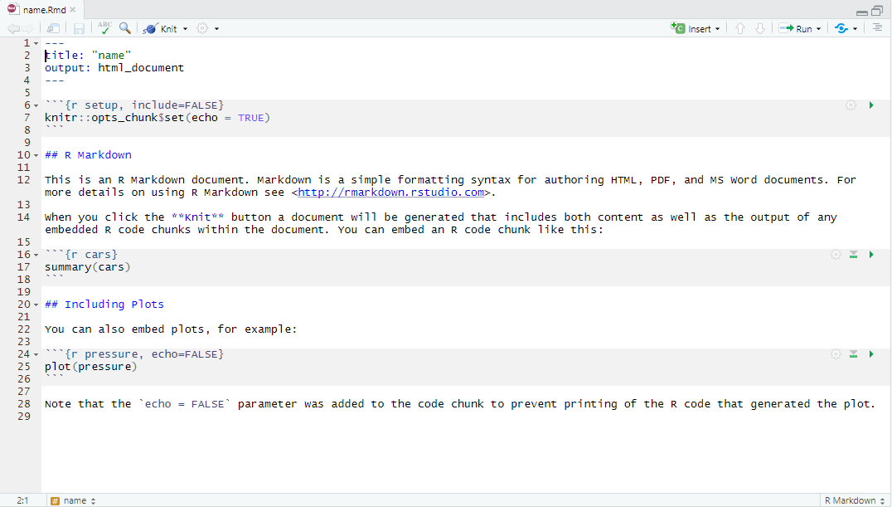
RMarkdown

Slide 22
Common causes of errors
Error | How to fix
Wrong type of data | Identify via class() then change i.e. as.data.frame()
Cannot find function | Run library(package) again
Syntax error | A mistype, look for this
Packages not liking each other | Restart session Ctrl+Shift+F10, call each package when needed
Anything else | Google error message!
Notes:
Do not call all packages you (think you) need at the very beginning!

Slide 23

Rememeber!
StackExchange is your friend
Always leave comments in your script
Switch to RMarkdown when writing
There is no one correct way of doing things

Slide 24
Resources
https://r4ds.had.co.nz/ #R for Data Science
https://otexts.com/fpp2/intro.html #Forecasting and time series in R
http://www.stat.columbia.edu/~tzheng/files/Rcolor.pdf #colour codes

